Slide 1
ORIENTATION Day 2
김수헌 KAICD 연구원
Notes:
In this presentation, I mainly focus on thesis research ,
Today`s presentation I would to introduce :
- What is main objective thesis work ?
- What problems I m trying to solve by having this research
- How my proposed computational approach address Ithose problems
- Which experiment implemented
- what is main contribution of this work ?
More detailed information about contents today`s representation

Slide 2
Drug Discovery
INTRODUCTION
ORIENTATION
Developing and discovering a new drug is a very costly and time consuming process, which can take ~12 years with a cost of 2.8$ billion dollar
2-3 years
1-3 years
5-6 years
1-2 years

Slide 3
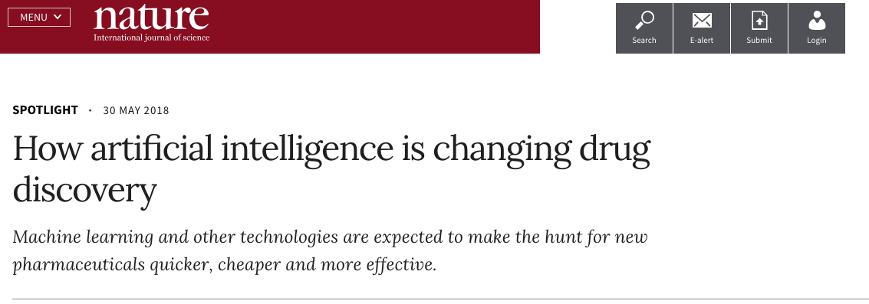
AI Driven Drug Discovery
AI
ORIENTATION
0.5 – 1 year
3 years
1-2 years

Slide 4
AI DRUG DISCOVERY
ORIENTATION

Slide 5
BIOMEDICAL OPEN DATA SOURCE
ORIENTATION
Disease
Compound
Protein
Genomics
Pathways

Slide 6
BIOLOGICAL GRAPH
ORIENTATION
Compound

Slide 7
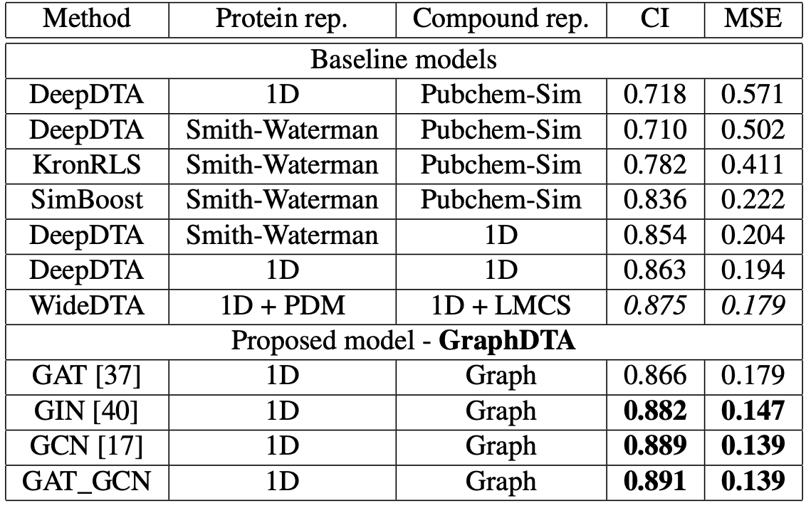
GraphDTA

Slide 8
Agenda
ORIENTATION

